Slide 1




The Smart Bird Feeder
EET411L – Final Project

Slide 2
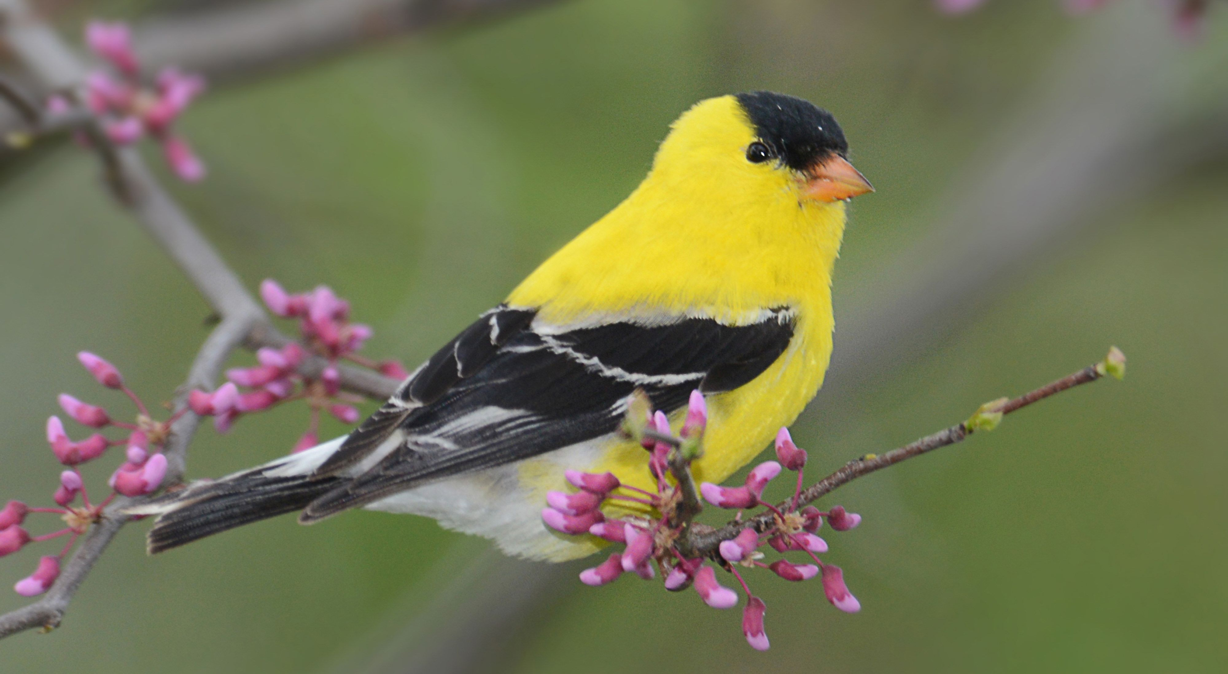
Project Team 4
Jeffery Wheeler – Project Lead
Joshua Tilson
Sean Copple
Valentin Wolf

Slide 3
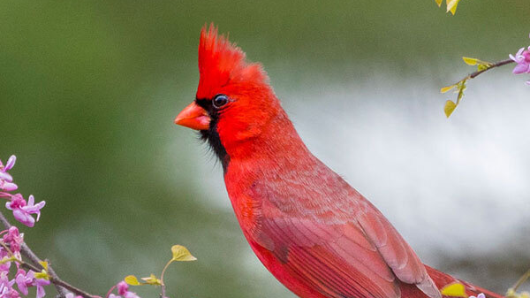
outline
Introduction
Project Description
How to Use It
Block Diagram
Detailed Schematic
Flowchart
How It Works
Parts List
Conclusion

Slide 4
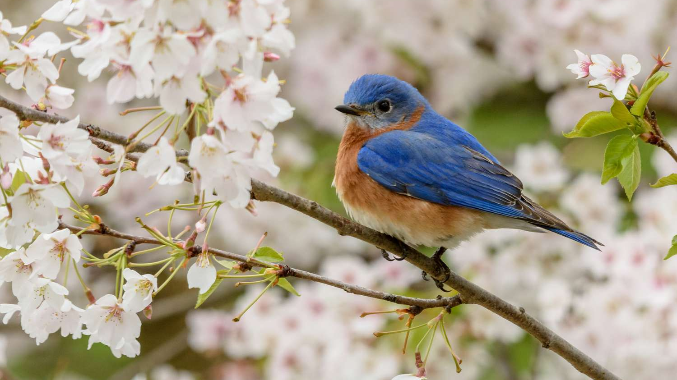
Introduction
"The Smart Bird Feeder is designed to allow birds access to food while preventing larger animals from stealing it. It uses sensors, servos, a load cell, and a solar-powered system to deliver food only to birds while monitoring food levels and system status."

Slide 5
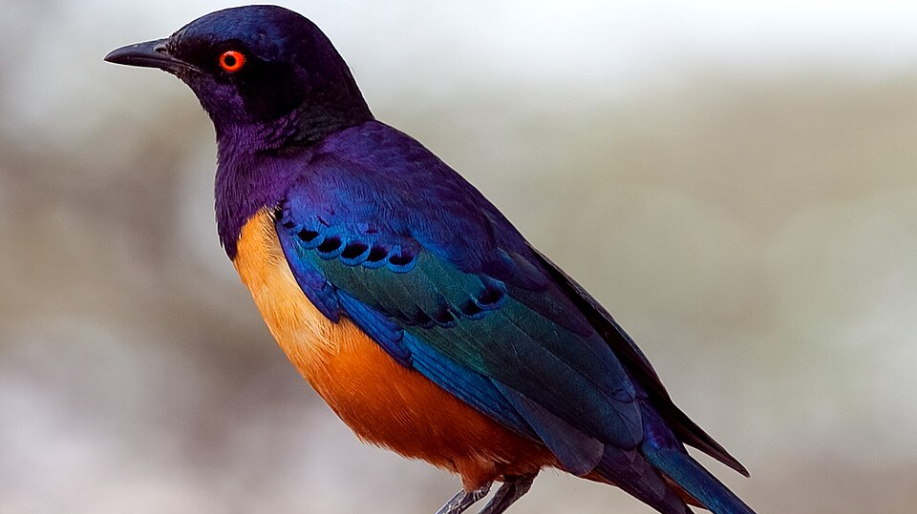
Project Description
Key Functions:
Solar-powered system with tracking for maximum energy capture
Load cell to detect bird weight
Servo-controlled food gate
Light sensors to track day/night cycles
Food level monitoring
Safety sensors to protect birds from gate movement

Slide 6
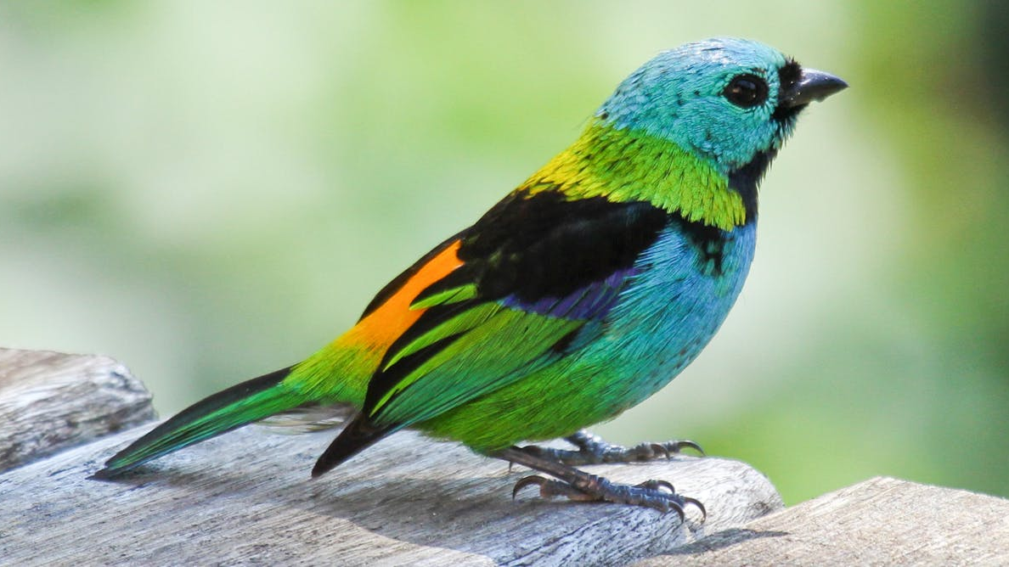
How to Use It
Place the bird feeder outdoors where it can get full sunlight.
Attach the solar tracker, making sure it can move freely and
follow the sun.
Fill the food container through the top hatch.
Turn on the system – the Raspberry Pi Pico W will automatically
start all functions.
The feeder runs on its own:
Sensors check weight to allow only birds.
A servo dispenses food in small portions.
Sensor errors are detected and logged.
At night, the system goes into standby mode.

Slide 7
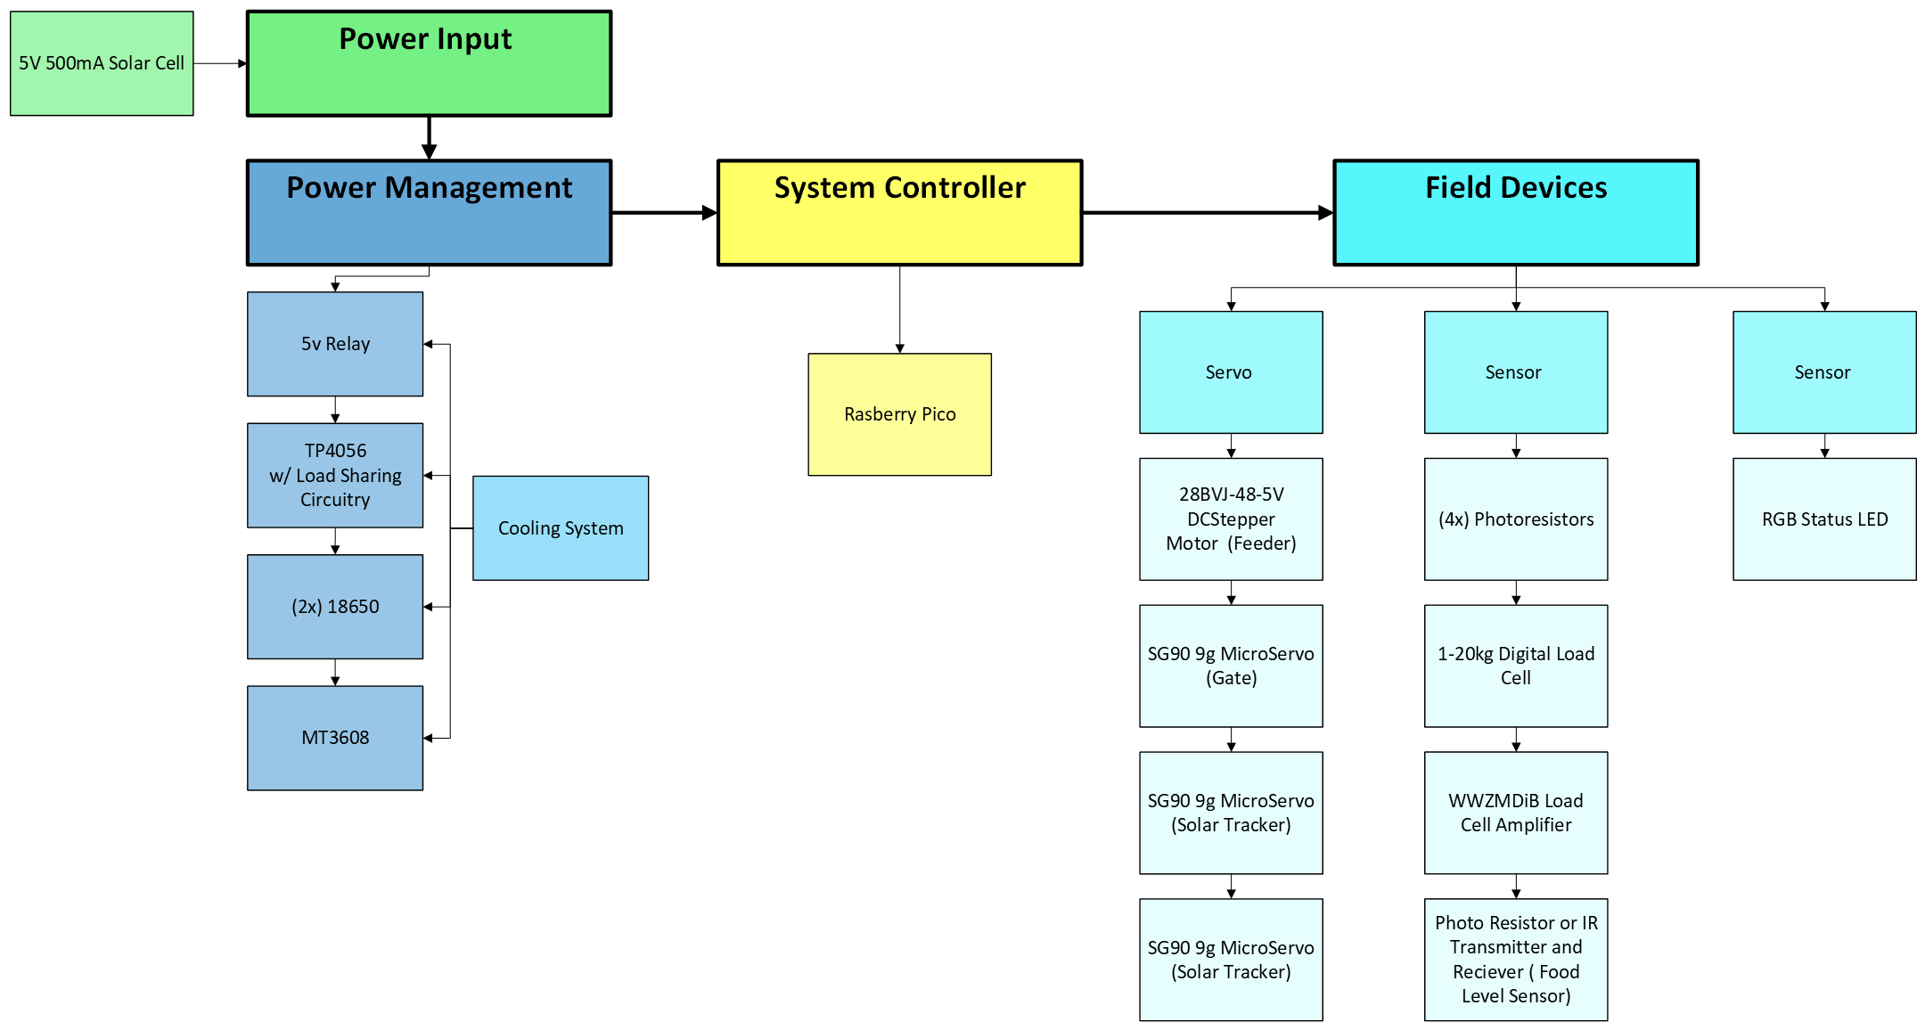
Block Diagram

Slide 8
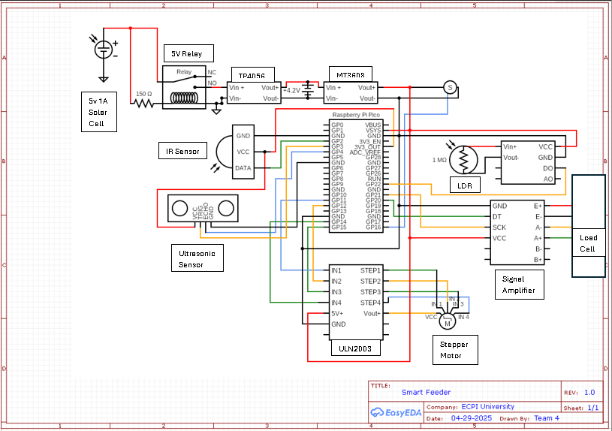
Detailed Schematic

Slide 9
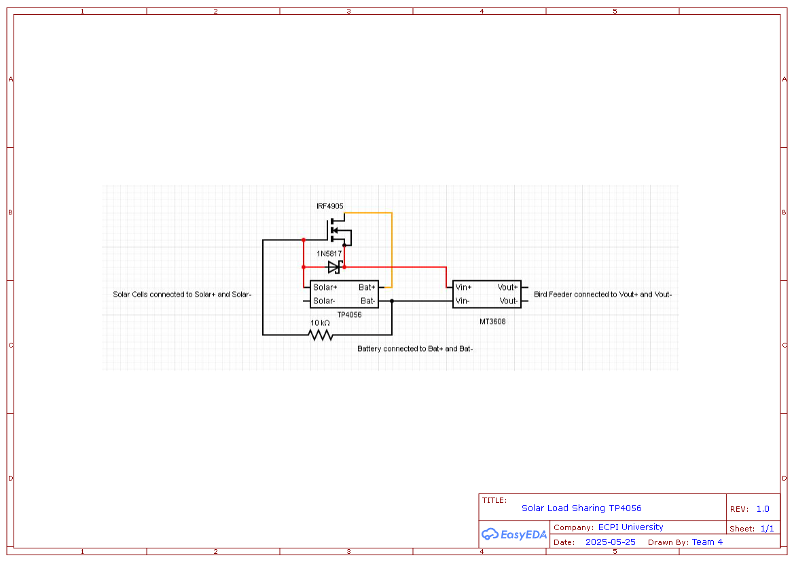
Detailed Schematic

Slide 10
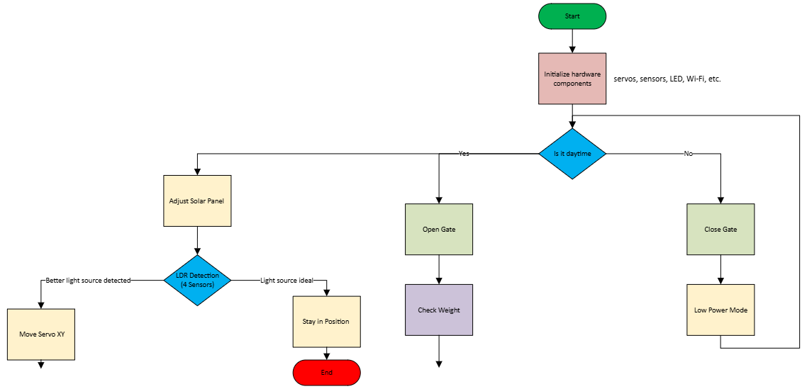
Flowchart

Slide 11
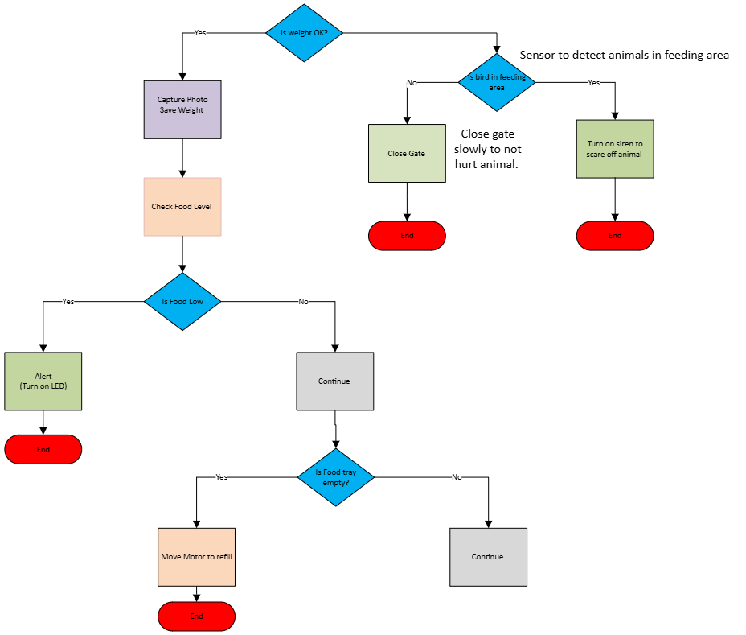

Slide 12
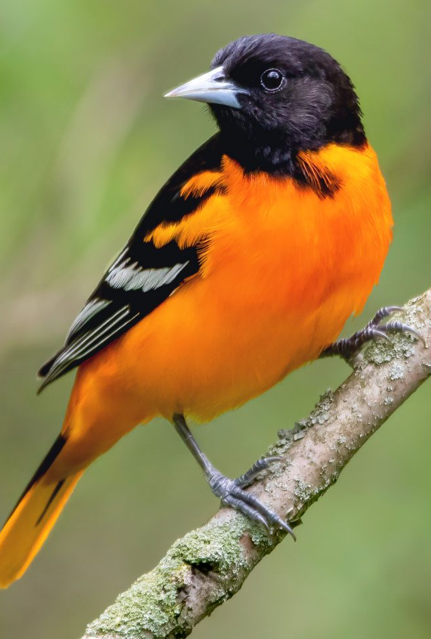
How It Works
During the day, the light sensors activate the system. If an object lands on the feeder, the load cell checks the weight. If it matches a bird, the servo opens the gate. If the weight is too high, access is denied. Safety sensors ensure the gate does not harm animals. If the tray is empty, the servo rotates the feeder wheel. Food levels and system status are monitored, and alerts are sent as needed. The solar tracker adjusts panel position for sunlight, and the power system manages battery charging efficiently. At night, the system enters low-power mode.

Slide 13
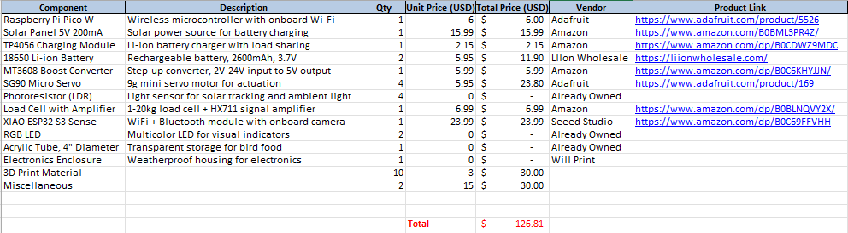
Parts List and budget

Slide 14
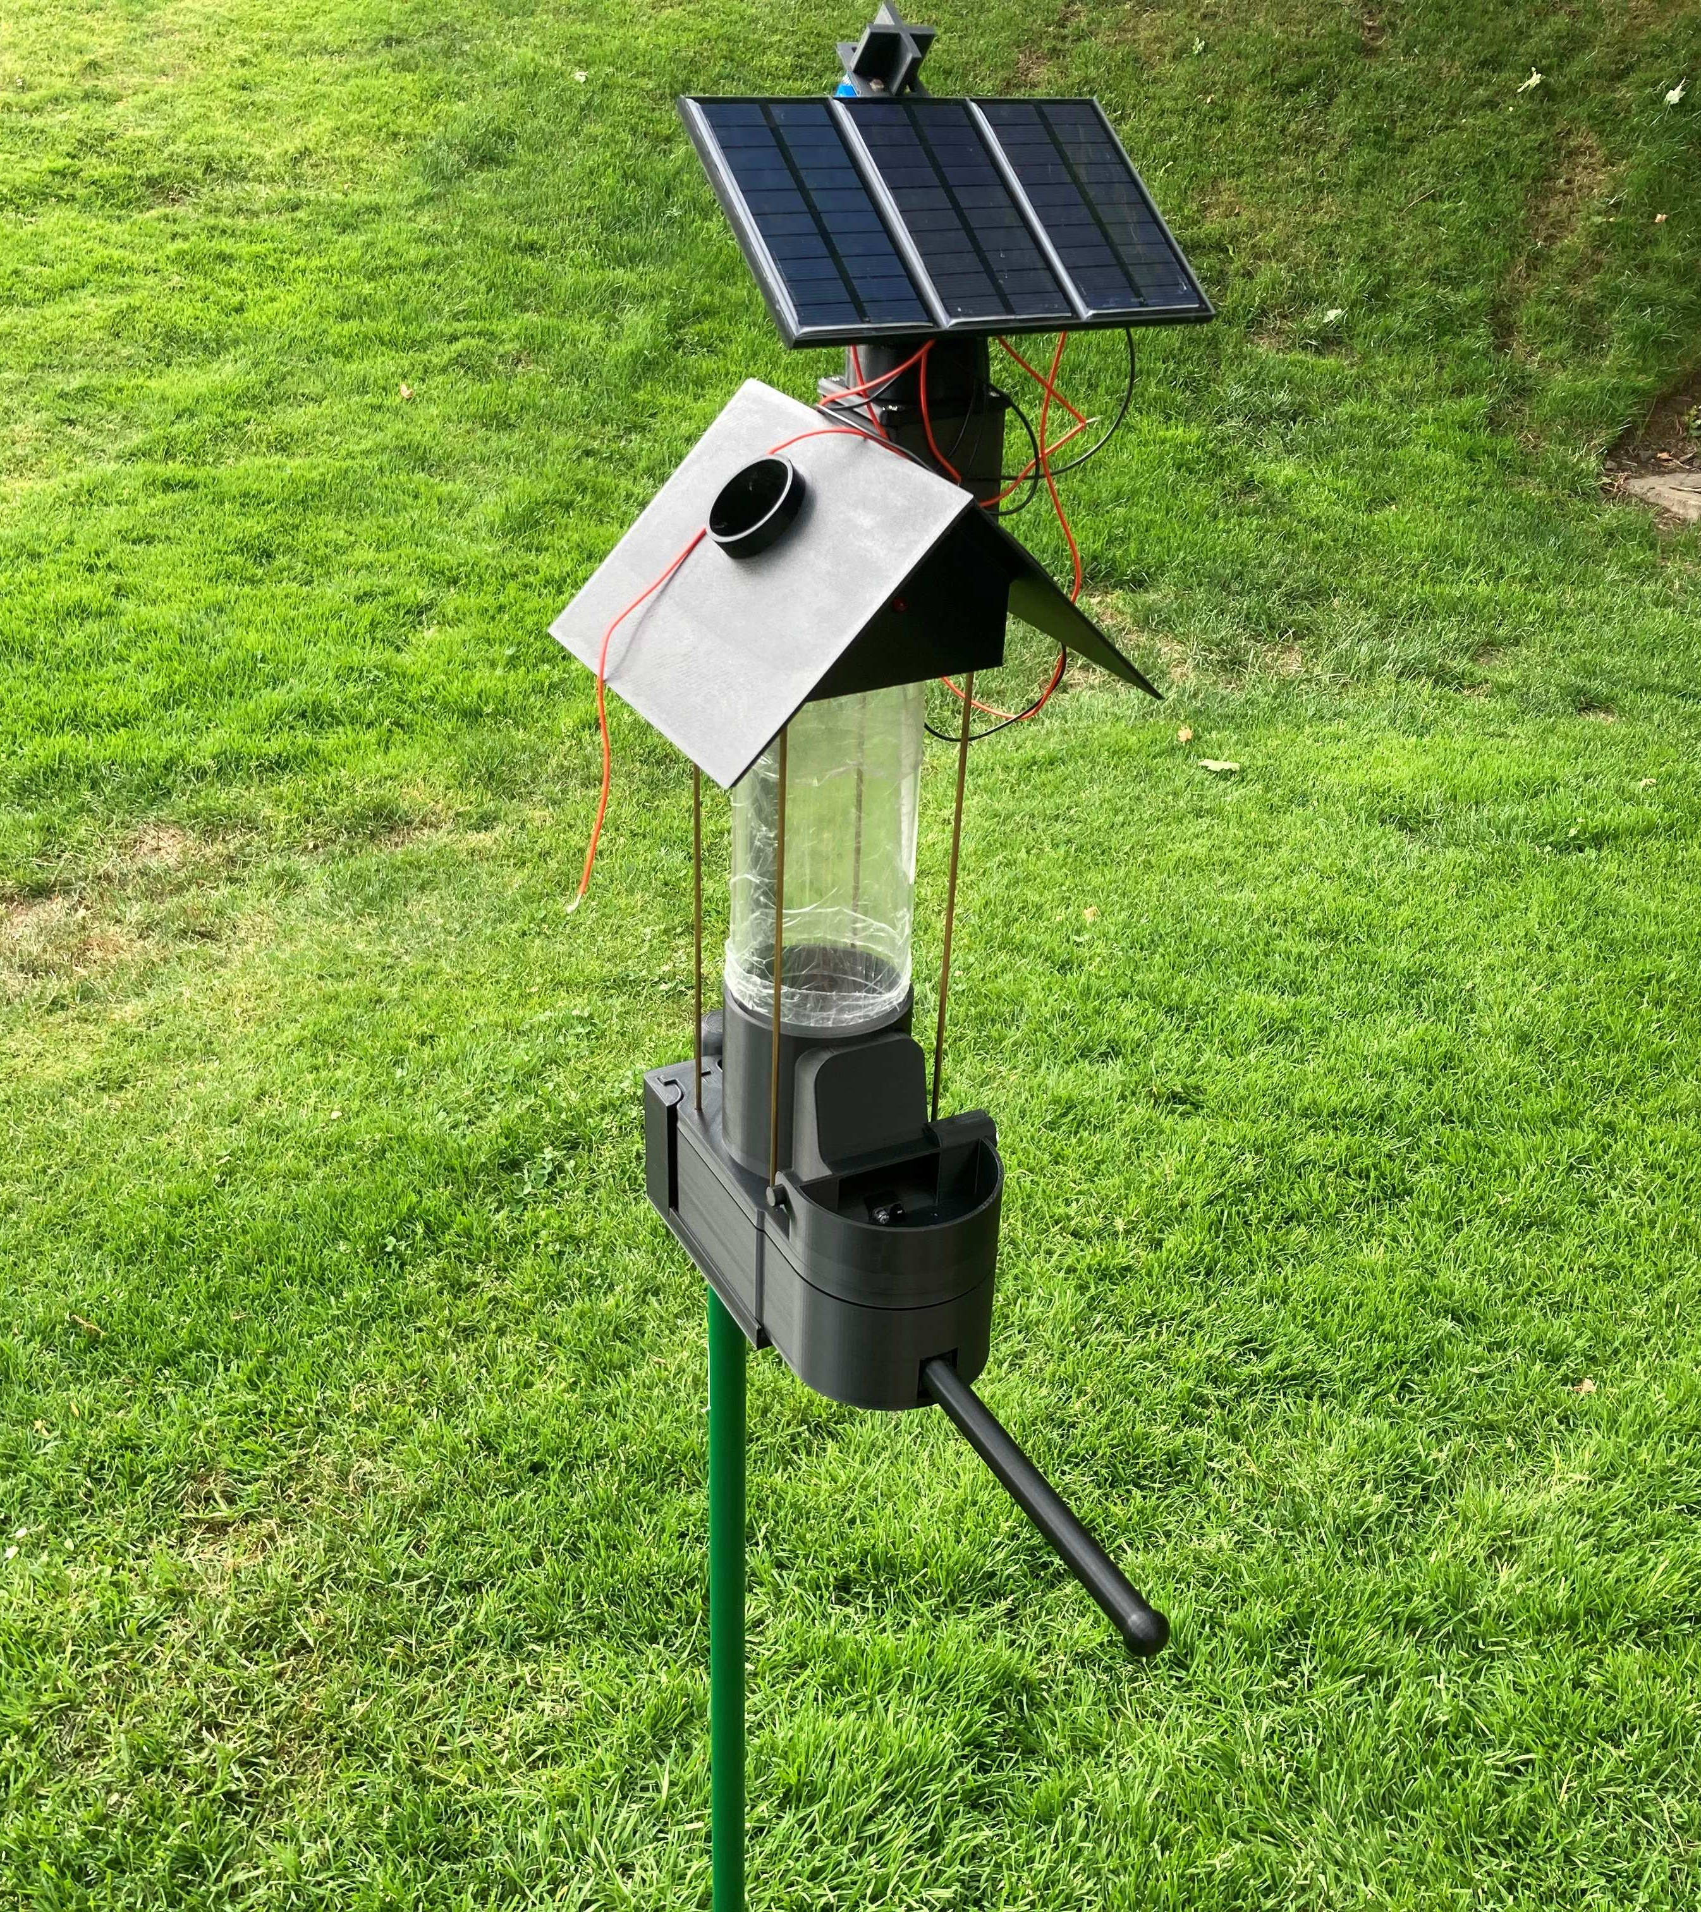
The Smart Bird Feeder

Slide 15
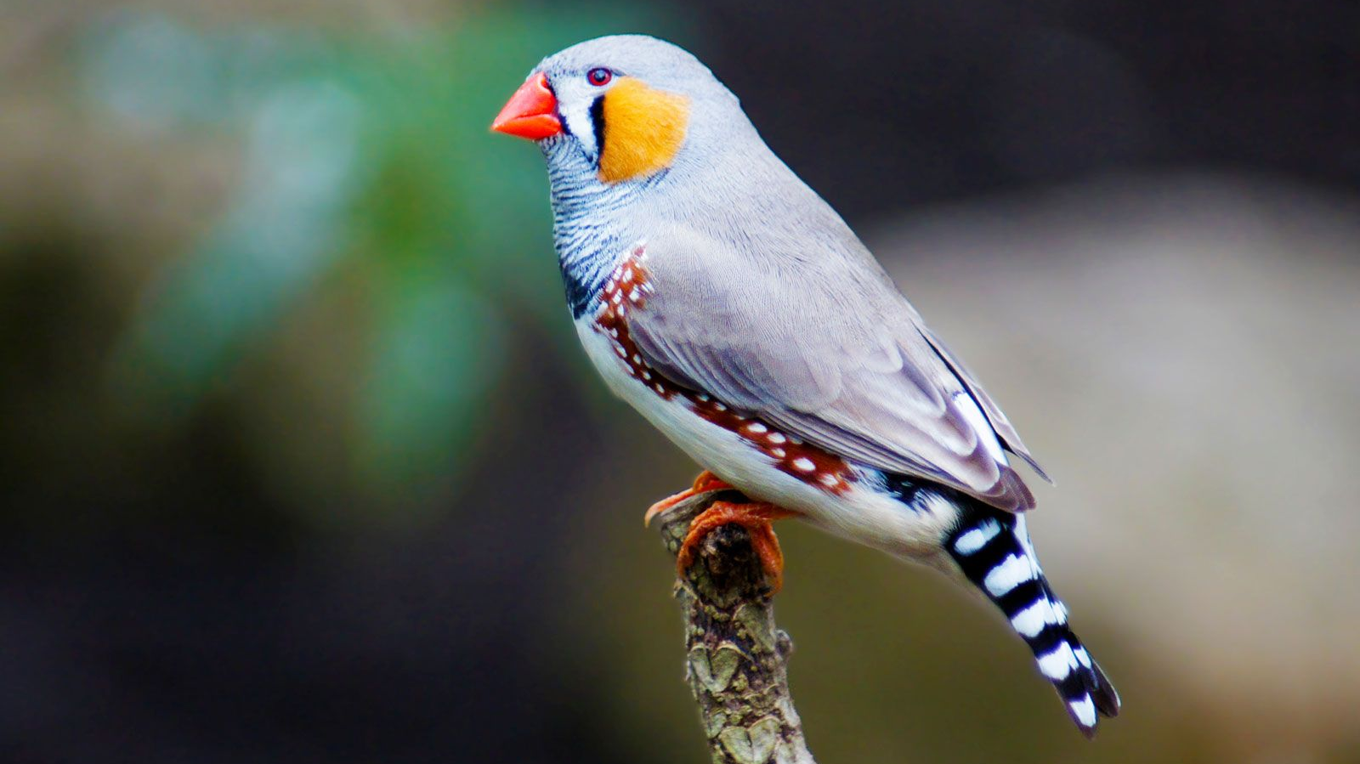
Conclusion
The smart bird feeder protects food from unwanted animals by using weight detection and automated access control. Safety and reliability have been improved through design changes. The system is solar-powered, weather-resistant, and features smart monitoring. Future improvements may include optional camera integration. Testing is ongoing and the system shows promising results.

